Slide 1

TinyURL Generator Project
Advance DSA with JAVA , LPU
By: Ashish Goswami (12319702)
A Java-based solution for efficient URL shortening and retrieval.

Slide 2


Slide 3
Agenda
01
02
Project Overview
Key Features
Understand the core concept and purpose.
Explore the functionalities of the generator.
03
04
Technical Foundation
Developer Insights
Dive into the underlying DSA and Java concepts.
Meet the creator and learn about the project's origin.

Slide 4

Project Overview
This project is a simple and efficient TinyURL Generator built in Java. It's designed to shorten long URLs into tiny, shareable links using hashing logic and data structures.

Slide 5
Key Features
URL Conversion
Fast Access
Converts long URLs into short, custom links.
Ensures rapid access and retrieval using HashMaps.
Java Collections
User-Friendly
Leverages the Java Collections Framework for hashing and data storage.
Designed to be beginner-friendly and easy to understand.

Slide 6

Technical Foundation
Hashing Logic
Data Structures
The core mechanism for generating unique short URLs from long ones.
Utilizes HashMaps for fast lookup and storage of URL pairs.
This allows for quick retrieval of original URLs from their shortened versions.
This ensures efficient mapping and prevents collisions.

Slide 7
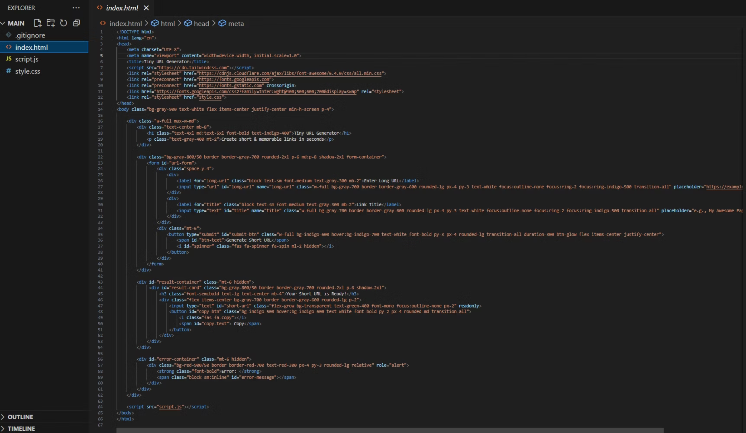
CODE INPUT
HTML.

Slide 8
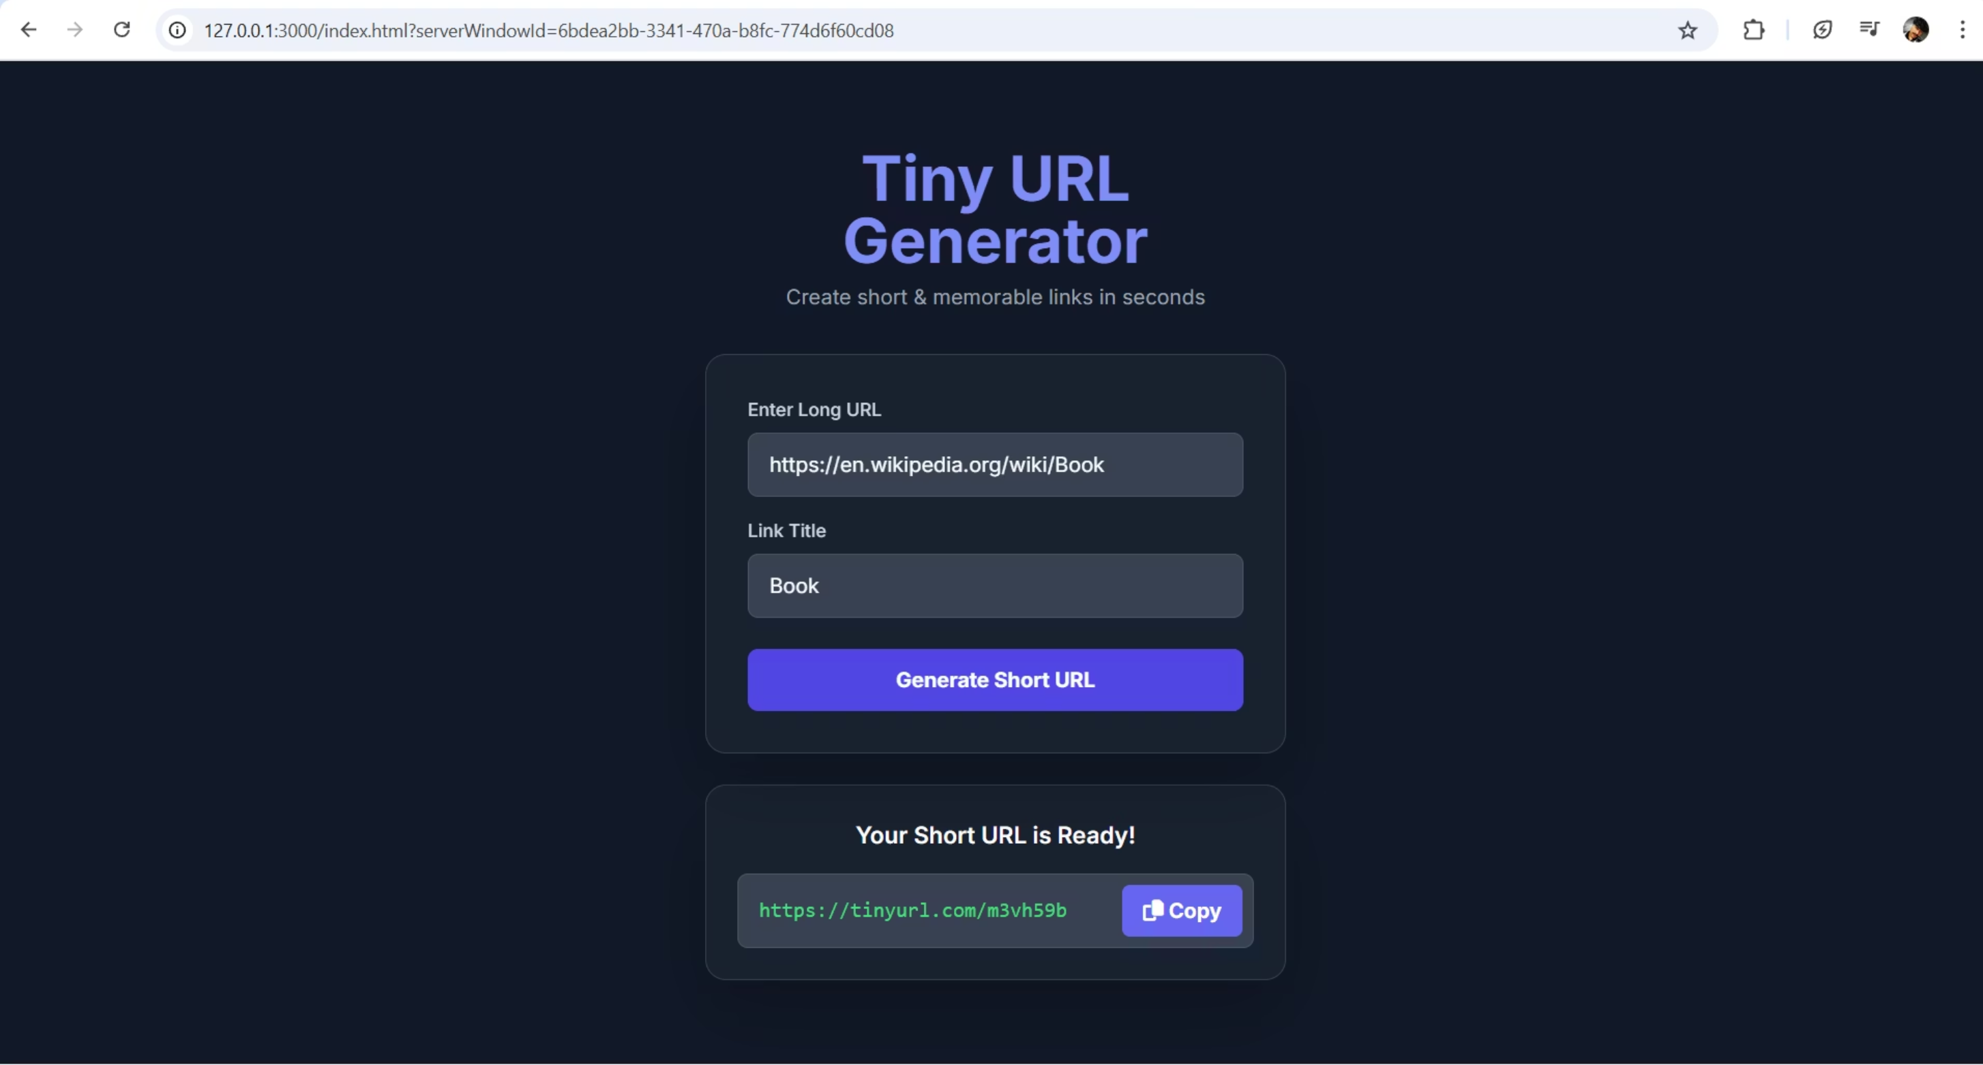
CODE OUTPUT ( LIVE PREVIEW)

Slide 9
Project Files
main
Contains the core Java project files.
.gitignore
Specifies intentionally untracked files to ignore.
README.md
Project documentation and overview.
index.html
Frontend HTML structure.
script.js
Frontend JavaScript logic.
style.css
Frontend CSS styling.

Slide 10

Developed By
Ashish Goswami
ashishgoswami93746@gmail.com
GitHub: ashishgoswami1

Slide 11

Languages Used
HTML
JavaScript
CSS
The project primarily uses HTML for structure, JavaScript for interactivity, and CSS for styling, alongside its core Java backend.

Slide 12

Github Live Link…
Thank you for your interest in the TinyURL Generator Project.

